Slide 1

Presented By:
Ctrl’ Z
Starting By:
Abdullah Al Galib
Kamrul Hasan
Rakib Uddin Chowdhury

Slide 2

Definition
Basically, a converter is a hardware or software which can able to convert any data one from another platform.
There are different kinds of converter in hardware or software platform.
We are going to discuss about some converter in software platform.

Slide 3

Temperature Converter
It is a process which can able to convert temperature from different platform.
It can convert Fahrenheit to Celsius.
It can convert Celsius to Fahrenheit.
It can convert Fahrenheit to Kelvin.
It can convert Kelvin to Fahrenheit.
It can convert Celsius to Kelvin.
It can convert Kelvin to Celsius.

Slide 4

Fahrenheit to Celsius
Formula
(F - 32) / 1.8

Slide 5

Celsius to Fahrenheit
Formula
(1.8 * C) + 32

Slide 6
Fahrenheit to Kelvin
Formula
(5/9 * (fahrenheit - 32) + 273.15)

Slide 7
Kelvin to Fahrenheit
Formula
(K - 273.15) * 9/5 + 32

Slide 8
Celsius to Kelvin
Formula
C + 273.15

Slide 9
Kelvin to Celsius
Formula
K - 273.15

Slide 10
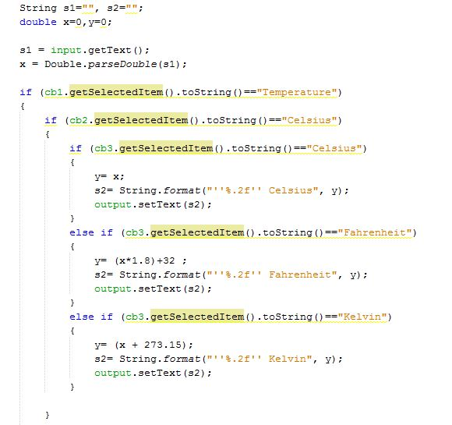
Temperature Code

Slide 11
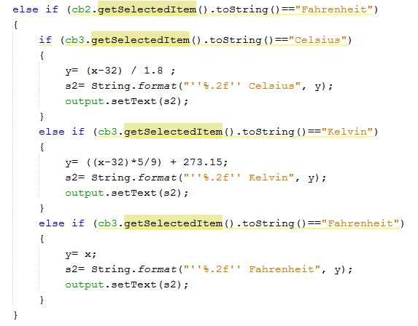
Temperature Code

Slide 12
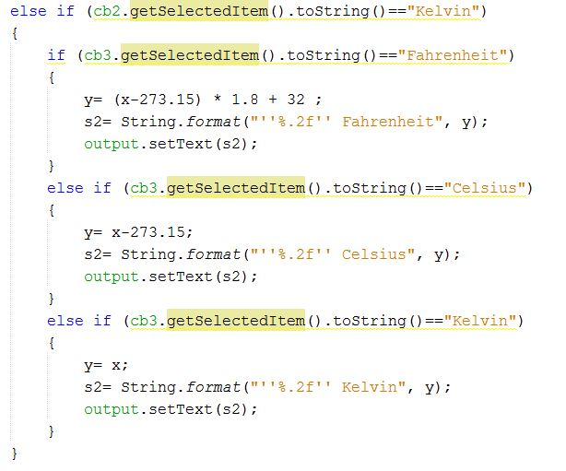
Temperature Code

Slide 13
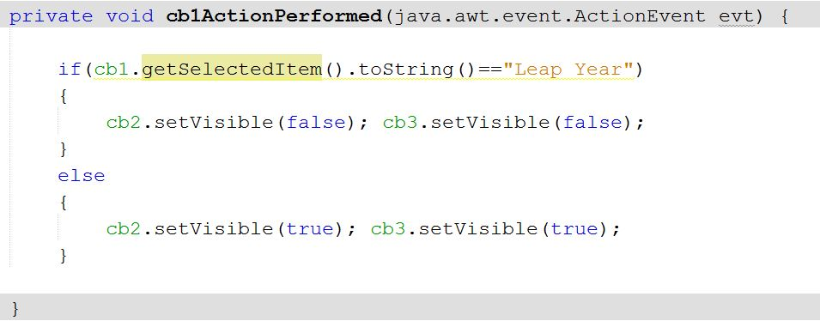
Box Hiding Code

Slide 14

Leap Year Finder
It is a process
which can able to show any year
that is Leap year or not.

Slide 15
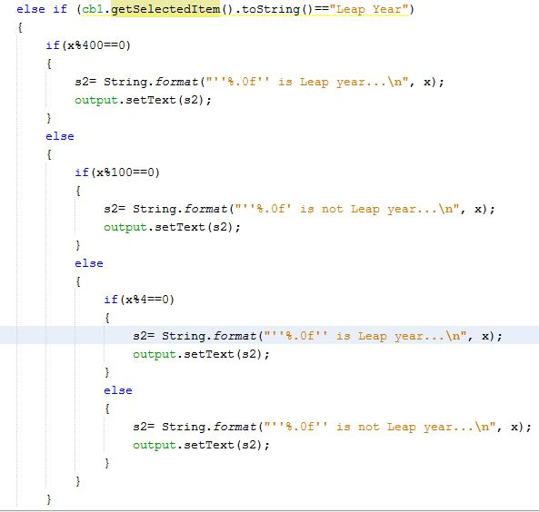
Leap Year Finder code

Slide 16
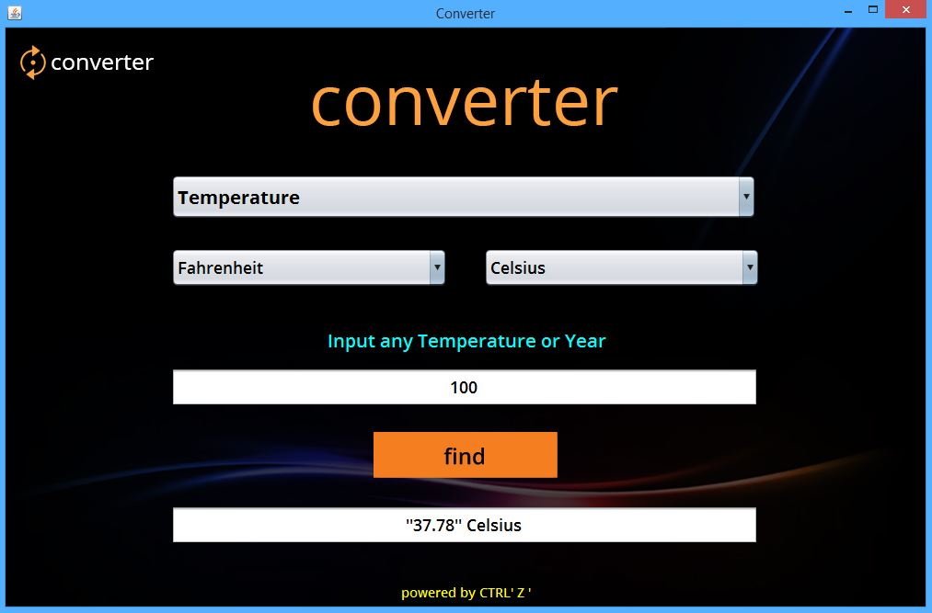
User manual of UI

Slide 17
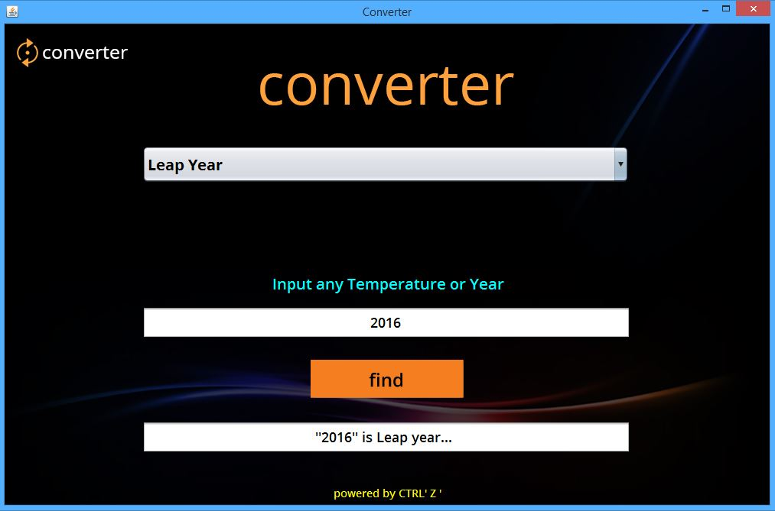
User manual of UI

Slide 18

Advantages
This application is very popular today.
There are lots of application like this.
It is very easy to use. We did not add large information, but we need some upgrade and its our dream.
Any people aged from 6 to 64 can use this application very easily.
It gives you the correct information about temperature.
It gives you the correct information about leap year.
The interface is also very user friendly.

Slide 19

Thank you for staying with us
Anything you are want to know … Please ask

